Slide 1
DL Assignment PPT
Error back Propagation with different number of hidden layers
MT21MCS008 - AKSHAY DHULE

Slide 2
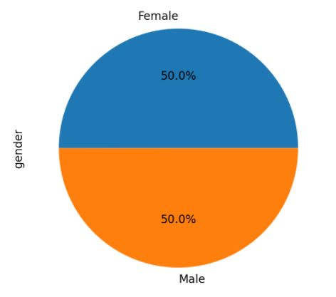
GENDER CLASSIFICATION DATASET
A simple way to classify the gender with some of the given features like Long_hair, forehead_width_cm, Forehead_height_cm, nose_wide, nose_long,lips_thin, distance_nose_to_lip_long
Shape of data : 5001 rows × 8 columns
Output class : - Male and Female
Training data : 3500 x 7
Testing data : 1501 x 7

Slide 3
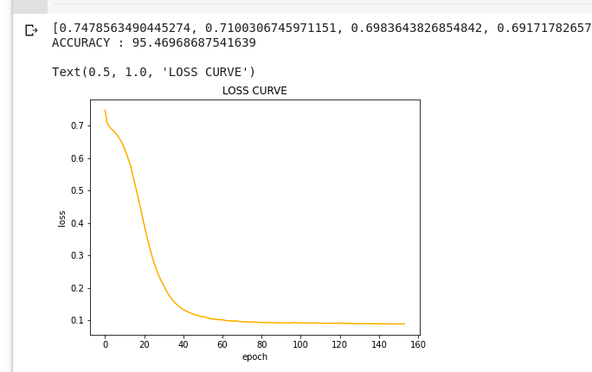
GRAPH WITH 2 HIDDEN LAYERS

Slide 4
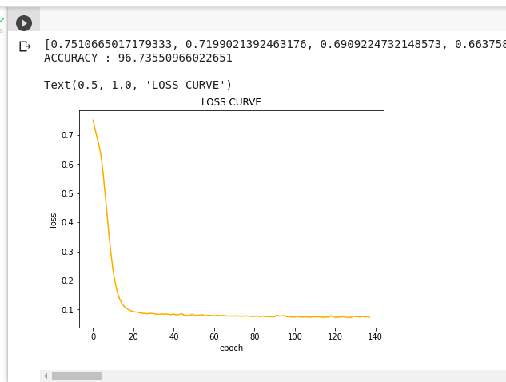
2. GRAPH WITH 8 HIDDEN LAYERS

Slide 5
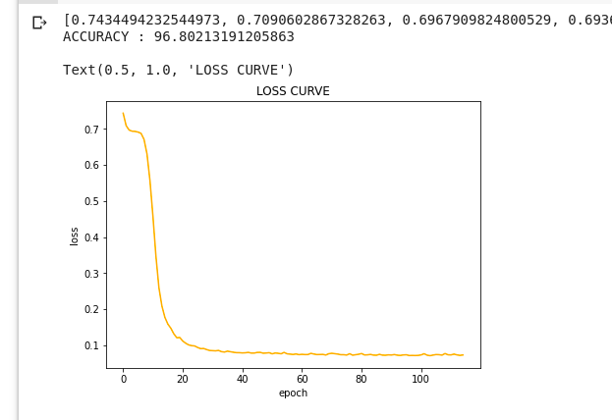
3. GRAPH WITH 15 HIDDEN LAYERS

Slide 6
CONCLUSION-
From the graphs we can say that the accuracy is slightly increasing with the increase in the number of hidden layers.
But it is not computationally good as it requires more time to train a model with 15 hidden layers and its just slightly increasing the accuracy we can say that the increase in number of hidden layer is slightly increasing the accuracy but with the high performance cost.
As we can see in the graph, the error is reduced and constant after 40 iterations with 2 hidden layers, but as with increase in number of hidden layer the graph shows we achieve the same reduction in error in half of the previous iterations i.e in 20 iterations and after that the error is constant.

